Slide 1
Data Science Applications: NLP, Computer Vision, IoT (UCS672) IoT security and privacy

Slide 2
Security Concerns
As we rely increasingly on smart, interconnected appliances in our lives, billions of "things" can threaten personal confidentiality and public safety through cyberattacks and external interference.
Security is one of the greatest considerations concerning IoT, which needs to be acknowledged along with the overarching need for safety, as the physical world is intricately linked to both concerns.

Slide 3
Privacy Concerns
The best way to protect data is not to collect the data in the first place. Since nonessential data or data which is not needed to meet requirements simply puts privacy at risk.
Responsibility for securing the data begins the moment we collect it, so it is always advisable only to collect the data that is required and ensure the protection of the collected data.
The data collection should always begin with the user's consent. Even though the data collection begins with consent, it is necessary to provide protection to ensure privacy and the collected information remains confidential.
For example, a patient health record should be only accessible by the patient and the doctor and necessary steps should be taken to ensure the protection of this data unless the patient provides consent to share.
It is important to dispose of the data which is no longer needed and to achieve this, proper data retention and data disposal policies should be in place.

Slide 4
Security risks in IoT
IoT has created entirely new businesses and revenue streams or delivers a more efficient experience for consumers. Along with this, it also creates new opportunities for all that information to be compromised. Not only is more data being shared through IoT among many more devices, but more sensitive data is being shared. As a result, the risks are exponentially greater.
IoT attacks: DDoS-Distributed Denial of Service, Weak Authentication Attacks, Privacy Violations and Data Leakage Attacks, and Malware Injection Attacks

Slide 5
DDoS-Distributed Denial of Service
It is a DoS (Denial of Device) attack that uses multiple computers or machines to flood a targeted resource. It occurs when an attacker or attackers attempt to make it hard or impossible for a service to deliver by overloading it with requests to virtually anything: services, devices, networks applications and even specific transactions within the application.
Since DDoS uses multiple systems, it will be hard to track the source system that is causing the attack, overloading volume is high, and due to the speed of this attack, it will be hard to detect flooding before it is too late, and the outcome/damage is high or sometimes even catastrophic.
Examples of DDoS attacks in IoT are Mirai
Notes:
examples of DDoS attacks in IoT are Mirai –it is malware that infects smart devices that run on ARC (Argonaut RISC Core) processors, turning them into a network of remotely controlled bots or “zombies” This network of bots, called a botnet, inflects Linux systems, Reaper – Unlike MIRAI, REAPER majorly employs exploits that target disclosed vulnerabilities in IoT devices.

Slide 6
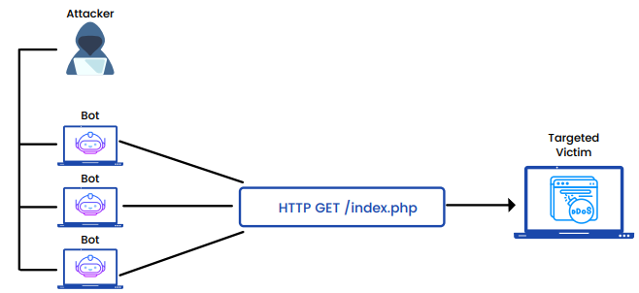
DDoS-Distributed Denial of Service

Slide 7
Hardware Security
Hardware security refers to utilizing physical devices to protect our IoT devices.
Hardware-based security solutions boost the device’s performance and work more efficiently.
These solutions are operated on a chip, and they are enhanced well to perform their tasks.
They follow two procedures encryption and decryption, and it is far more efficient than any other normal processor.
Sensitive data such as keys and random generators are encrypted into the hardware, which in turn will be difficult to trace.
Implementing a hardware solution may be costly, and sometimes it requires a lot of time and effort, but this can help to keep our sensitive data safe and assures that it does not get leaked.

Slide 8
Hardware Security
Types of Attacks on Hardware
Side-Channel Attack: It is a kind of attack in which a secure system is attacked using an insecure system, i.e., the system that is not secured. For example, the attackers can easily access the file if they remove the hard drive and connect it to another pc.
Rowhammer Attack: In this attack, the values which are in the row of a memory cell are modified and thus result in alteration of the neighbour rows. They can insert malicious codes that may consist of kernel-level privileges.
Hardware Trojan Attack: It is a kind of malicious circuit that destroys the function or reliability of the electronic system. The Trojan functions consist of removing, controlling, altering, and sneaking the design contents. There is no device implemented to detect these Trojans.

Slide 9
Weak Authentication Attacks
Authentication can be viewed as the first line of security by enforcement of security measures at level 0.
Weak Authentication describes any scenario in which the strength of the authentication mechanism is relatively weak compared to the value of the assets being protected and scenarios in which the authentication mechanism is flawed or vulnerable.
When the control system of the IoT has a weak authentication system, the attacker can log in by brute-forcing or using the default password lists.

Slide 10
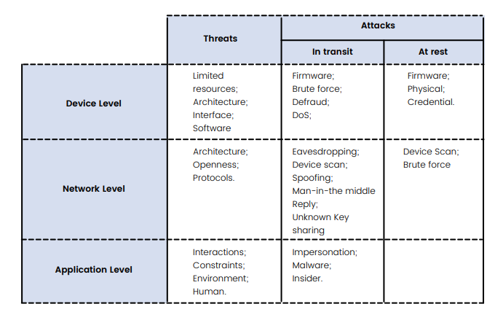
Weak Authentication Attacks

Slide 11
Privacy Violations and Data Leakage Attacks
Mishandling a user’s password, social security numbers, and other private information can compromise user privacy and is often illegal. Privacy violations occur when private user information enters the application, and the data is written to an external location such as the console, file system, or network.
Physical or electronic data leakage is the unauthorized transmission of data within an organization to an external recipient.
Notes:
As we rely increasingly on smart, interconnected appliances in our lives, billions of "things" can threaten personal confidentiality and public safety through cyberattacks and external interference. Security is one of the greatest considerations concerning IoT, which needs to be acknowledged along with the overarching need for safety, as the physical world is intricately linked to both concerns.

Slide 12
Malware Injection Attacks
In an injection attack, an attacker supplies untrusted or malicious input to a program.
This input gets processed by an interpreter as part of a command or query. In turn, this alters the execution of that program.
As injection attacks are a very well-understood vulnerability class, many freely available and reliable tools allow even inexperienced attackers to abuse these vulnerabilities automatically.
Malware injection attack is a sub-category of Injection attacks. Here the cyber attacker creates a malicious application and injects it into Software as a Service (SaaS), Platform as a Service (PaaS), and Infrastructure as a Service (IaaS), respectively

Slide 13
IoT Security Standards Protocols
IoT network protocols are used to link devices over a network.
These are the communication protocols that are most commonly used on the internet.
End-to-end communication protocol within the network’s domain is possible with IoT network protocols.
The National Institute of Standards and Technology (NIST) is a non-regulatory body of the United States Department of Commerce specializing in physical sciences. Its purpose is to encourage industrial productivity and innovation.
NIST for Cybersecurity

Slide 14
IoT Security Standards Protocols
NIST for Cybersecurity
The Cybersecurity Framework is a set of guidelines for private sector businesses to adopt to be better equipped to find, detect, and react to cyber-attacks. It was developed by the National Institute of Standards and Technology, which is part of the US Commerce Department.
The challenge is aimed to promote device and data protection across business sectors and at scale in the Internet of Things (IoT) community. NIST is involved in a variety of IoT and IoT-related projects.

Slide 15
IoT Security Standards Protocols
Technologists can select from multiple communication protocols when building a network to serve their IoT ecosystem.
AMQP: Advanced Message Queuing Protocol
Bluetooth
BLE- Bluetooth Low Energy: new version optimized for IoT connections.
Cellular: one of the most widely available and well-known options available for IoT applications
Notes:
https://www.techtarget.com/iotagenda/tip/Top-12-most-commonly-used-IoT-protocols-and-standards

